Slide 1
My Career
Craig R. Cohen, MD, MPH

Slide 2
Early Phase
Medical School
Residency OB/Gyn
Explore global health research interests
Apply to ID Fellowship at the University of Washington

Slide 3
Fellowship and Early Faculty Phase
Based at the University of Nairobi 1994-2002
Developed understanding of local health conditions
Developed partnerships
Beginning of building research team
Started to help train next generation of Kenyan researchers

Slide 4
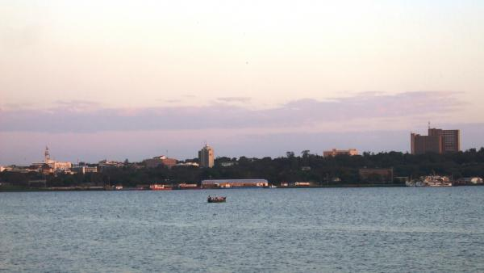
Mid-Faculty Phase
Transition to UCSF
Transition from Nairobi to Kisumu
Transition from University of Nairobi to KEMRI
Expansion of HIV research
Beginnings of Family AIDS Care & Education Services (FACES)

Slide 5
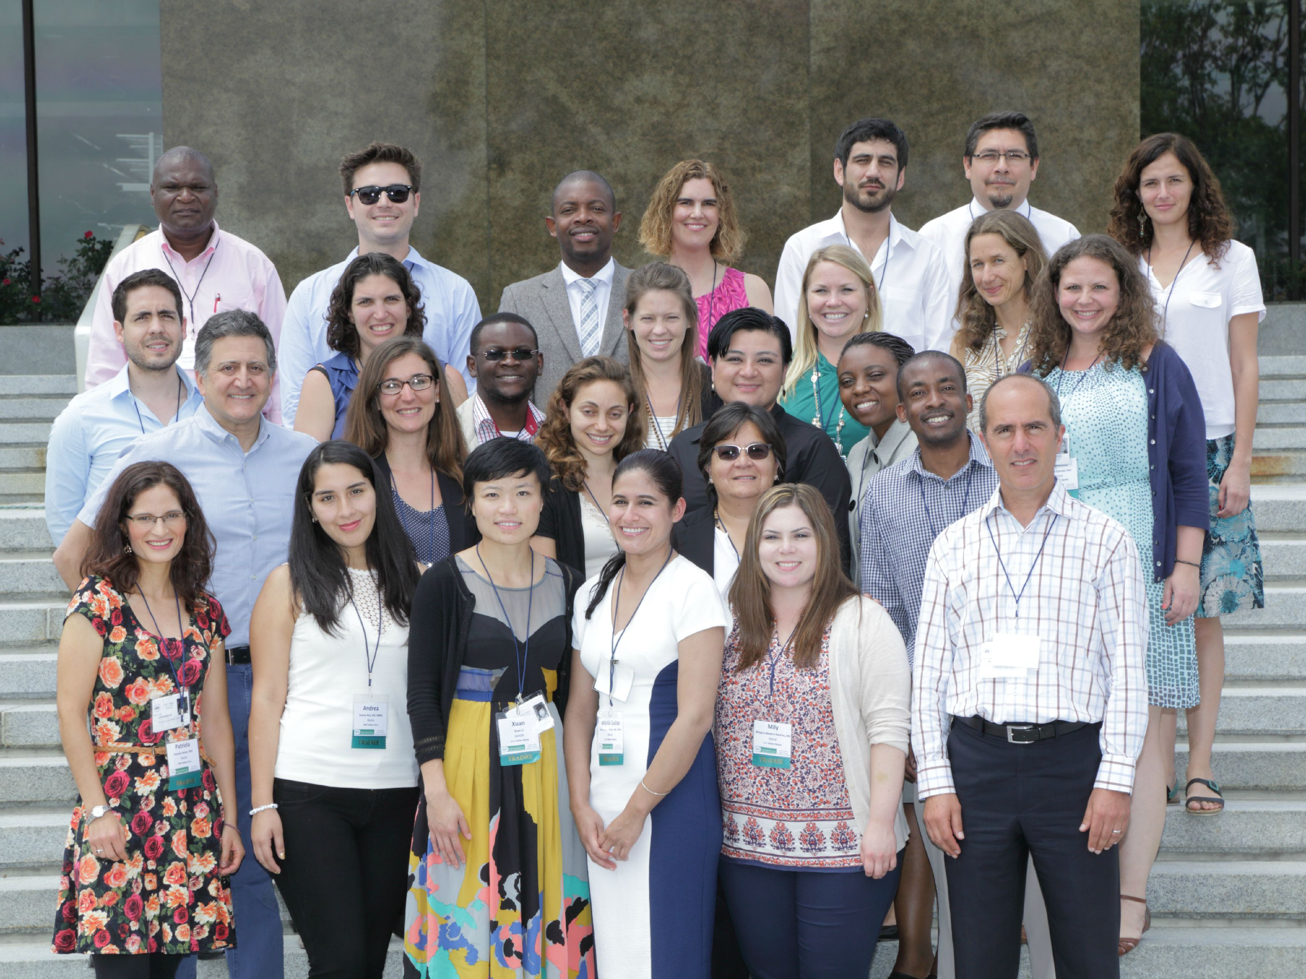
Later Faculty Phase
FACES as a foundation for ~20 studies
Incorporation of transdisciplinary global health paradigm
Management of ~$18M/year portfolio
Focus on leading training/mentoring programs
GloCal Fellowship
Reproductive Infectious Disease Fellowship
Mentorship initiative in LMIC institutions
Co-Director of UC Global Health Institute

Slide 6
