Slide 1
Grant Hartzog, Ph.D.
Peer Review and Publication
Professor of Molecular, Cell and Developmental Biology
University of California, Santa Cruz

Slide 2
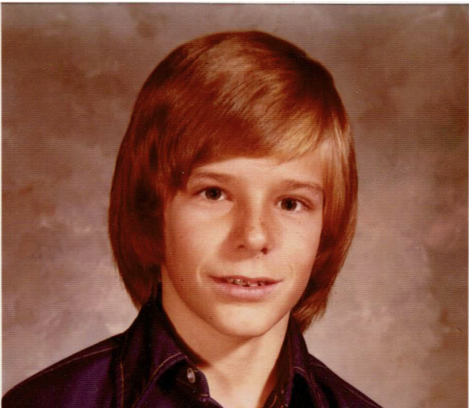
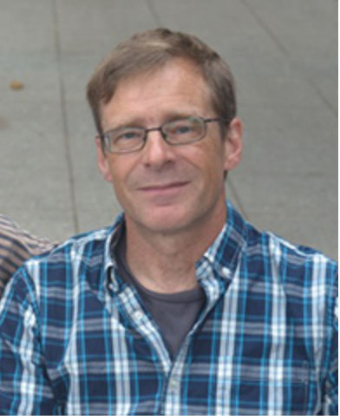
My Career Path
BA in Biophysics
UC Berkeley, 1984
Medical School → MD/PhD program → PhD
UC San Francisco
PhD in Biochemistry and Biophysics, 1992
Transcriptional regulation of the beta-globin promoter
Postdoctoral Fellowship in Genetics Department
Harvard Medical School, 1992-1998
Genetic analysis of chromatin and transcription in yeast
Professor of Molecular, Cellular and Developmental Biology
UC Santa Cruz, 1998-present
Notes:
Oklahoma---Philippines—Oklahoma—Sacramento

Slide 3
My Career Path
Professor of Molecular, Cellular and Developmental Biology
1998-2004, Assistant Professor
2004-2009, Associate Professor (with tenure)
2009-now, Professor
2018-now, Associate Dean, Physical and Biological Sciences Division
Research
Roles of Spt4/Spt5 in transcription elongation, chromatin maintenance and pre-mRNA processing
Defining the molecular basis of Wolbachia-host interactions
Funding
NIH and Foundations for graduate school
NIH, NSF, local cancer charity and internal university funds as an independent investigator
Administrative stipends
Notes:
When looking for jobs consider:
will I gain new knowledge and skills?
is this a place where I can be successful?
-are necessary resources available?
-is institution invested in my success?
-who are/will be my colleagues?

Slide 4
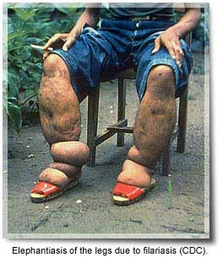
Why Global Health?
Teaching is largely centered on topics related to and students interested in healthcare
Recent interest in Wolbachia
Gram negative intracellular bacteria
Infect ~70% of all insect species, a number of filarial parasites of humans
Wolbachia is required for survival of adult filarial nematode
Wolbachia may reduce transmission of certain viruses by insects
(e.g., dengue, yellow fever, chikunga, Zika)
River blindness
Onchocerca volvulus
Elephentiasis
Brugia malayi
Notes:
Global health education will meet needs of students who wish to serve their communities locally as well as students who are interested in working internationally.

Slide 5
Peer Review and Publication
Goal: Find the widest possible audience for your work
Process:
Author submits manuscript, with cover letter, to journal
Editor evaluates for suitability
Expert reviewers
No thank you
Not suitable
Appropriate for journal

Slide 6
Peer Review and Publication
Goal: Find the widest possible audience for your work
Process:
Editor evaluates reviews
Expert reviewers
Reviews completed and returned
~2-4 weeks

Slide 7
Peer Review and Publication
Goal: Find the widest possible audience for your work
Process:
Manuscript accepted for publication
Editor evaluates reviews
Expert reviewers
No thank you
rejects
Reviews completed and returned
~2-4 weeks

Slide 8
Peer Review and Publication
Goal: Find the widest possible audience for your work
Process:
Author revises manuscript, with point-by-point response to reviewers
Returned for revision
Revised manuscript
resubmitted
Editor evaluates reviews
Send for re-review
Expert reviewers
Reviews completed and returned

Slide 9
Peer Review and Publication
Goal: Find the widest possible audience for your work
Process:
Author revises manuscript, with point-by-point response to reviewers
Manuscript accepted for publication
Returned for revision
Revised manuscript
resubmitted
Editor evaluates reviews
Expert reviewers
No thank you
rejects
Reviews completed and returned

Slide 10
Peer Review and Publication: Tips
Pick an appropriate journal
Read the journal’s instructions to authors
Write a clear cover letter
Editor may not be an expert in your subfield
Put your work in context
What important problem is addressed?
What is the main message of the paper?
Why appropriate for this journal and of interest to its readers?
Consider your potential reviewers
Read reviews carefully
Get advice from colleagues
Notes:
Frequently, journals ask for a list of potential reviewers (outside of your institution and free from conflicts—i.e., no collaborators)
They may also give you the option to exclude certain people (competitors) as reviewers, but they are under no obligation to honor your wishes.

