Slide 1
A Peripatetic Career Path
Arthur L. Reingold, MD
Professor and Division Head, Epidemiology
School of Public Health

Slide 2
Autodidact
One who is self-educated

Slide 3
Arthur Reingold’s Education and Training
1970: BA (Biology)
1976: MD
1976-1978: Residency, Internal Medicine
1979-1981: Epidemic Intelligence Service, CDC
1981-1982: Preventive Medicine Residency, CDC

Slide 4
Arthur Reingold’s Public Health Work Experience
Local/County Health Department:
  San Francisco Department of Public Health
State Health Department:
  Connecticut State Department of Health
National:
  Centers for Disease Control and Prevention (CDC)
International:
  Multiple Ministries of Health and the World Health Organization (WHO)

Slide 5
Self-Educated or Uneducated?
“If he doesn’t have a brain, how did he get to be a professor?”
University of California, Berkeley
Epidemiology Graduate Student Satirical Skit
Circa 1992

Slide 6
The “Education of Arthur Reingold”: Other Life Skills
Hepatitis B transmitted by an oral surgeon
Effectiveness of Meningococcal A vaccine
Early detection of epidemics
Menstrual Toxic Shock Syndrome and tampons
Transmission of M. tuberculosis

Slide 7
Hepatitis B transmitted by an oral surgeon, Connecticut, 1979
Problem:
Routine case report forms for 3 patients with acute hepatitis B - all mentioned recent dental work; when asked, all 3 patients had seen the same oral surgeon
Approach:
Historical cohort study of patients of the oral surgeon

Slide 9
Table 2. Prevalence of seropositivity for markers of hepatitis B virus among non-institutionalized patients of a seropositive oral surgeon, by year of surgery
Year | No. of patients seropositive/no. tested (%) | P value*
1977 | 4/84 (4.8) | 0.43
1978 | 15/204 (7.4) | 0.02
1979 | 33/223 (14.8) | 0.00001
NOTE. Seropositivity was defined as the presence of hepatitis B surface antigen or antibody to hepatitis B surface antigen.
*Calculated by binomial distribution. The expected value was 4.0%.

Slide 11
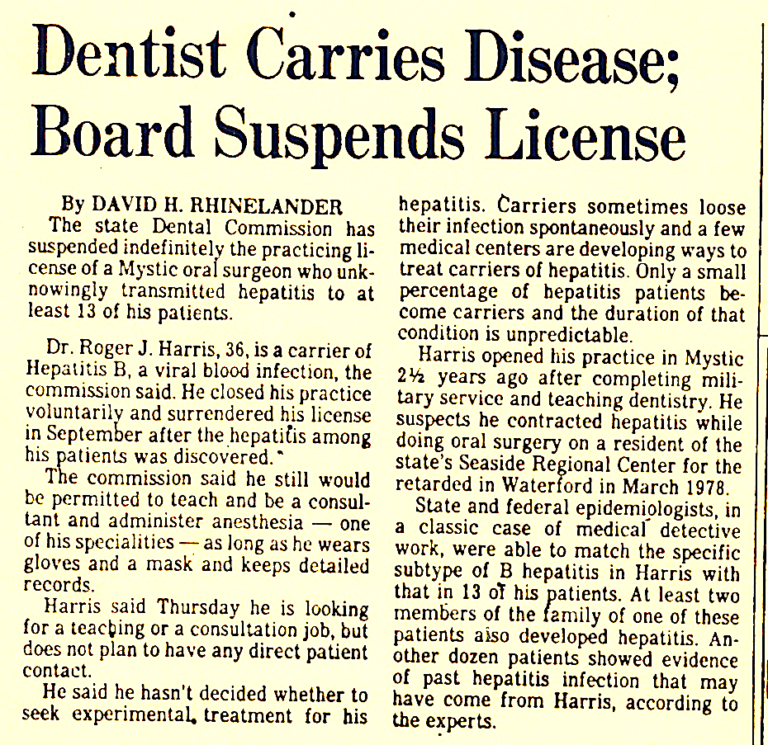

Slide 12
Hepatitis B transmitted by an oral surgeon, Connecticut, 1979
Lesson Learned:
Be cautious (our findings have impact)

Slide 13
Epidemic Meningococcal Meningitis,
West Africa, 1982-1984
Problem:
Extensive use of serogroup A polysaccharide vaccine in 1981; unknown duration of vaccine-induced protection
Approach:
Case-control study of vaccine effectiveness

Slide 14
Epidemic Meningococcal Meningitis,
West Africa, 1982-1984
Results:
Vaccine-induced protection lasted at least three years when vaccine was given to older children (≥ 4 years of age); it lasted only one year when given to younger children and infants (1, 2, and 3 year olds)

Slide 15
Epidemic Meningococcal Meningitis,
West Africa, 1982-1984
Lesson Learned:
Be selective (in your choice of mentors)

Slide 16
Epidemic Meningococcal Meningitis, Nepal
(and back in West Africa), 1983-84 and beyond
Problem:
Meningitis epidemics occur unpredictably; late detection and delayed response leads to increased morbidity and mortality
Approach:
Use of routine surveillance data in models to examine performance characteristics of various threshold rates to predict epidemics

Slide 17
Epidemic Meningococcal Meningitis, Nepal (and back in West Africa), 1983-84 and beyond
Results:
Sensitivity, specificity, and positive- and negative predictive values of various weekly rates of meningitis for predicting impending epidemics estimated and optimal rate identified; incorporated into WHO guidelines and country programs

Slide 18
Epidemic Meningococcal Meningitis, Nepal (and back in West Africa), 1983-84 and beyond
Lesson Learned:
  Be humble (someone else has always done it before)

Slide 20


Slide 21
Epidemic Meningococcal Meningitis, Nepal (and back in West Africa), 1983-84 and beyond
Lesson Learned:
  Be well dressed (appearances matter)

Slide 22
Menstrual Toxic Shock Syndrome and Tampons, 1980
Problem:
Increasing number of cases of Staphylococcal Toxic Shock Syndrome (TSS) in young women during menstruation; risk factors unknown
Approach:
Case-control study of risk factors

Slide 23
Menstrual Toxic Shock Syndrome & Tampons, 1980
Results:
Strong association with tampon use in general and with Rely® brand tampon use in particular
Findings attacked by industry-paid consultants and lawsuits filed demanding names of study participants

Slide 25


Slide 27
Menstrual Toxic Shock Syndrome & Tampons, 1980 (continued)
Lesson Learned:
Be Resilient (you will be challenged, even attacked)

Slide 28
Effect of HIV Infection on Transmission of M. tuberculosis, Dominican Republic, 1994-95
Problem:
Effect of HIV infection on likelihood of transmitting M. tuberculosis by patients with pulmonary TB unknown
Approach:
Prospective cohort study of household contacts of HIV-positive and HIV-negative patients with pulmonary TB

Slide 29
Effect of HIV Infection on Transmission of M. tuberculosis, Dominican Republic, 1994-95
Results:
HIV-positive patients with pulmonary TB significantly less likely to transmit M. tuberculosis to household contacts

Slide 30
Effect of HIV Infection on Transmission of M. tuberculosis, Dominican Republic, 1994-95
Lancet Reviewer:
“A well conducted case control study of tuberculosis in HIV-infected individuals and its spread within households at risk.”

Slide 31
Effect of HIV Infection on Transmission of M. tuberculosis, Dominican Republic,
Lesson Learned:
Be skeptical (that those who should understand epidemiologic concepts do)

Slide 32
Summary
If you don’t know where you are going, any path can take you there

